Slide 1

Cardiovascular Risk Prediction with Stable Explanations
HDS-5330-03
Prof : Bahareh Rahmani
Shruthi Reddy Vudem

Slide 2
Goal: Build an AI model to predict cardiovascular disease risk and study how stable its explanations are when training conditions change.
  Context: Cardiovascular disease is a leading global cause of death. Clinicians need not only accurate predictions, but also reliable and stable explanations.
  Rationale: If feature importance changes a lot across random seeds, clinicians may not trust the model. We compare an Explainable Boosting Machine (EBM) and XGBoost with SHAP explanations.

Slide 3
Study Design & Data
Dataset: Public cardiovascular risk dataset (cardio_train.csv).
  Features: Demographics (age, gender), vital signs (blood pressure), and lab values (cholesterol, glucose), with a binary target cardio (0/1).
  Design: Single train/test split (80/20, stratified), median imputation, and feature engineering followed by:
  • ExplainableBoostingClassifier (EBM)
  • XGBoost + SHAP feature importance
  both run across multiple random seeds.

Slide 4
Modeling Approach & Stability Analysis
Models:
• ExplainableBoostingClassifier (interpretable boosting model)
• XGBClassifier (gradient boosted trees) with SHAP explanations
Metrics (per seed): accuracy, ROC-AUC, F1, precision, recall, confusion matrix, and Brier score.
Stability: Repeat training for N_SEEDS times, compute global feature importance for each run, then:
• Measure variance of importance per feature

Slide 5
EBM - features with LOWEST variance -most stable
feature variance_across_seeds
9 active 1.439146e-11
0 gender 1.991545e-11
7 smoke 3.264190e-11
8 alco 1.308805e-10
5 cholesterol 2.160728e-10
6 gluc 2.657832e-10
1 height 4.620823e-07
3 ap_hi 1.438624e-06
2 weight 2.146274e-06
4 ap_lo 3.756391e-06

Slide 6
XGBoost+SHAP - features with LOWEST variance -most stable
XGBoost+SHAP - features with LOWEST variance (most stable)
feature variance_across_seeds
8 alco 6.583055e-08
7 smoke 1.092101e-07
9 active 1.207692e-07
6 gluc 1.262253e-07
0 gender 3.298869e-07
5 cholesterol 8.279221e-07
1 height 9.729462e-07
10 age_years 1.168913e-06
11 BMI 2.827599e-06
2 weight 3.302994e-06

Slide 7
EBM - features with HIGHEST variance -least stable
feature variance_across_seeds
7 smoke 3.264190e-11
8 alco 1.308805e-10
5 cholesterol 2.160728e-10
6 gluc 2.657832e-10
1 height 4.620823e-07
3 ap_hi 1.438624e-06
2 weight 2.146274e-06
4 ap_lo 3.756391e-06
10 age_years 8.615941e-06
11 BMI 1.554541e-05

Slide 8
XGBoost+SHAP - features with HIGHEST variance - least stable
XGBoost+SHAP - features with HIGHEST variance (least stable)
feature variance_across_seeds
9 active 1.207692e-07
6 gluc 1.262253e-07
0 gender 3.298869e-07
5 cholesterol 8.279221e-07
1 height 9.729462e-07
10 age_years 1.168913e-06
11 BMI 2.827599e-06
2 weight 3.302994e-06
4 ap_lo 8.054466e-05
3 ap_hi 9.958568e-05

Slide 9
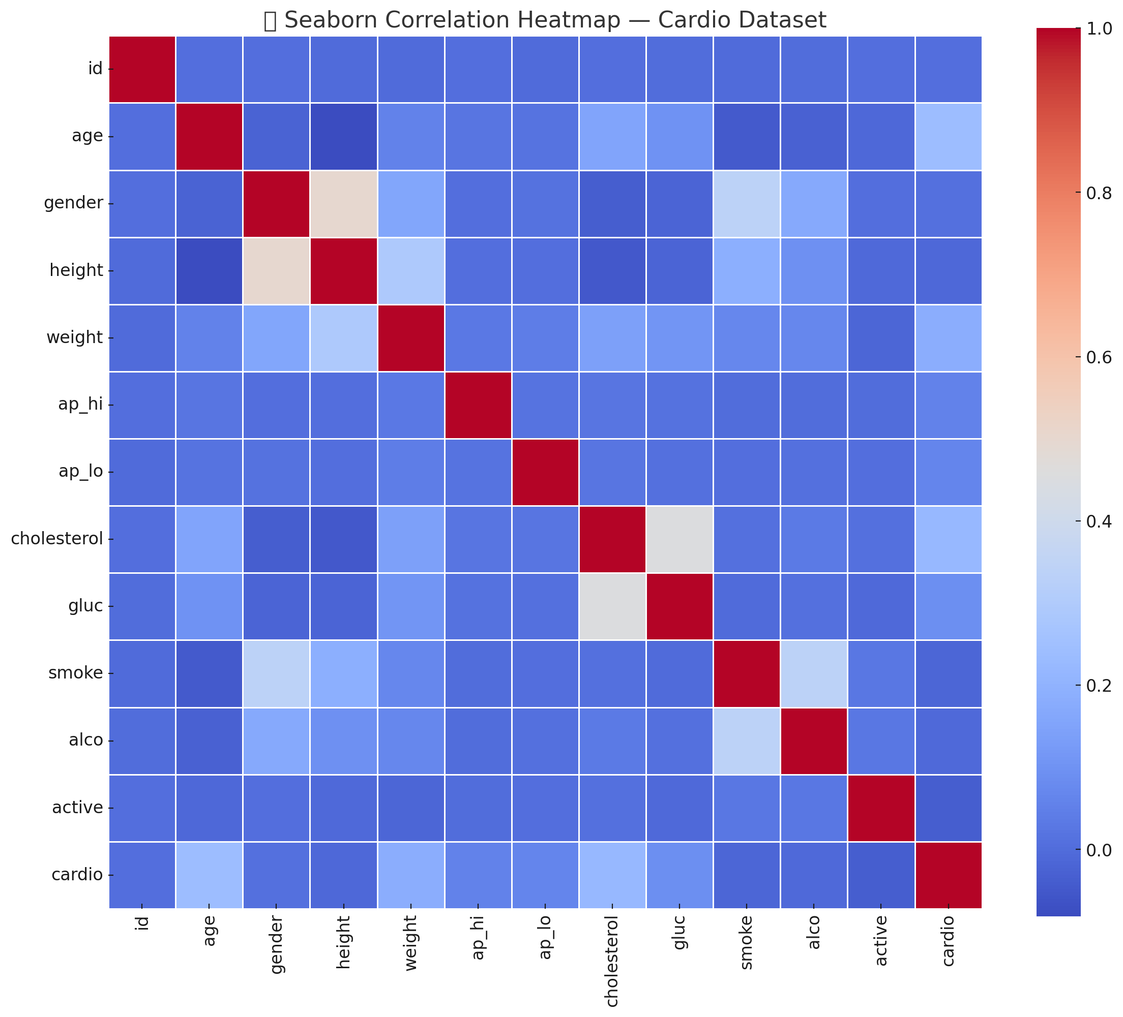
CORRELATION HEAT MAP

Slide 10
Strong correlations you can visually observe:
ap_hi ↔ ap_lo
Blood pressure systolic and diastolic are naturally positively correlated.
weight ↔ height
Expected anthropometric relationship.
cardio ↔ cholesterol / gluc
Higher cholesterol and glucose correlate with higher cardiovascular disease risk.
age ↔ cardio
Age shows moderate positive correlation with cardiovascular outcomes.

Slide 11
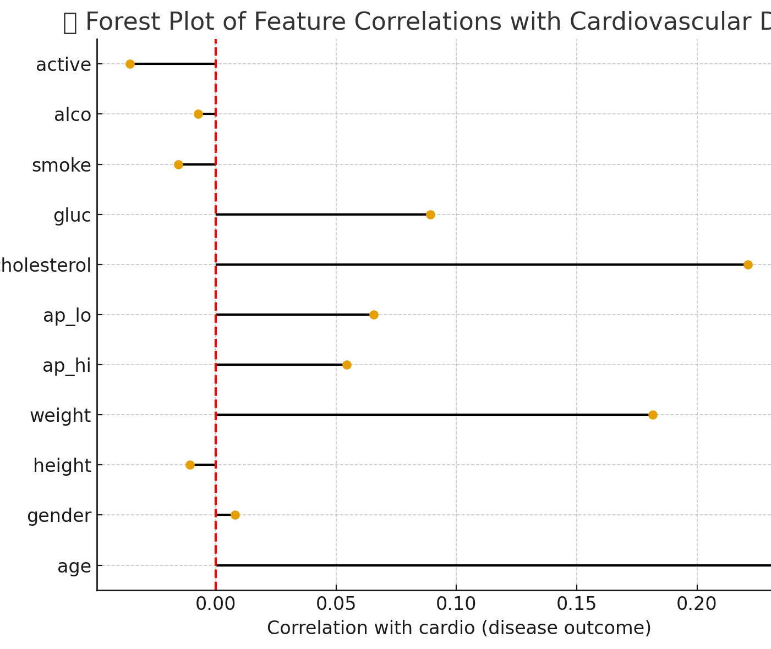
Forest plot -feature correlation with cardiovascular disease

Slide 12
Positive correlations → Higher risk of cardiovascular disease
Examples (stronger to weaker):
cholesterol
gluc
age
ap_hi
ap_lo
These match real clinical risk factors
Near-zero correlations → Little to no linear relationship
active
alco
smoke

Slide 13
Main Findings & Outputs
Across 20 random seeds, both EBM and XGBoost achieved strong and consistent predictive performance (good ROC-AUC, accuracy, and F1).
  Global feature importance was highly stable, with mean Spearman rank correlation ≈ 1.0 for EBM and ≈ 0.997 for XGBoost+SHAP across seeds.
  Physiological features like age, blood pressure, and cholesterol consistently appeared as top predictors in both models.

Slide 14
Key Takeaways & Clinical Implications
The model is not only accurate but also produces stable feature importance rankings, which is critical for clinical trust.
  Stable explanations mean clinicians can repeatedly see the same core risk factors (e.g., age, blood pressure), making the model easier to interpret and explain to patients.
  This framework can be extended into a clinical tool that flags high-risk patients in the EHR and provides transparent, consistent risk drivers at the bedside.

